Slide 1
Guidance on Synergies between European Structural and Investment Funds, Horizon 2020 and other innovation-related EU Funds
Dimitri Corpakis
Head of Unit RTD.B5
Spreading excellence and Widening participation
dimitri.corpakis@ec.europa.eu
November 2014

Slide 2
Europe’s innovation divide undermines competitiveness
Large parts of the EU out of ‘sync’
Modest and Moderate Innovators holding back the EU as a whole
Grand policy designs at risk without a sound and functioning base
Identification of priorities and strategies of crucial importance – yet still, among the major bottlenecks

Slide 3
EU R&D and Innovation Policy Horizon 2020 | EU Cohesion Policy
Differences
Based largely on individual R&D and innovation Projects of a pre-competitive nature aiming at advancing knowledge and fostering innovation for growth and jobs, including but not exclusively frontier research (also co-funding national and regional programmes) | Based on multiannual Programmes aiming to reduce regional disparities, including through close to the market competitive R&D and innovation efforts
Awarded directly to final beneficiaries (firms, public and private R&D centres and Universities, including national and regional governments in certain cases – Art. 185, ERA-NET etc.) | Awarded through shared management exclusively to national and regional public intermediaries
Through transnational competitive calls addressed to international groupings through peer review based in particular on excellence criteria | Non competitive attribution addressed to regional players based on strategic planning negotiation (however competitive calls possible and rising at national or regional level)
Synergies and Complementarities: towards a more competitive Europe
Horizon 2020 will focus on tackling major societal challenges, maximising the competitiveness impact of research and innovation (Industrial leadership) and raising and spreading levels of excellence in the research base | Cohesion policy will focus on galvanising smart specialisation that will act as a capacity building instrument, based on learning mechanisms and the creation of critical skills in regions and Member States.
3
3

Slide 4
Research and Innovation investment priorities for the ERDF
Strengthening research, technological development and innovation:
Enhancing research and innovation infrastructure (R&I) and capacities to develop R&I excellence and promoting centres of competence, in particular those of European interest
Promoting business R&I investment, product and service development, technology transfer, social innovation and public service application, demand simulation, networking, clusters and open innovation through smart specialisation
Supporting technological and applied research, pilot lines, early product validation actions, advanced manufacturing capabilities and first production in Key Enabling Technologies and diffusion of general purpose technologies
Notes:
4

Slide 5
The Synergies Matrix
 | STRUCTURAL FUNDS THEMATIC OBJECTIVE NO 1 ON STRENGTHENING RESEARCH, TECHNOLOGICAL DEVELOPMENT AND INNOVATION
HORIZON 2020 TOP DOWN RESEARCH AND INNOVATION PRIORITIES INFLUENCING NATIONAL AND REGIONAL PRIORITIES | THEMATIC CONCENTRATION FOR MOST ADVANCED AND TRANSITION REGIONS FOR ALLOCATING (80% -60%) OF THE ERDF MONEY FOR 4 OBJECTIVES: R&I, ICT, SME COMPETITIVENESS AND LOW CARBON ECONOMY | THEMATIC CONCENTRATION FOR LESS ADVANCED REGIONS FOR ALLOCATING 50% OF THE ERDF MONEY FOR 4 OBJECTIVES: R&I, ICT, SME COMPETITIVENESS AND LOW CARBON ECONOMY
EXCELLENCE | SMART SPECIALISATION EX-ANTE CONDITIONALITY based on a SWOT analysis to concentrate resources on a limited set of research and innovation priorities in compliance with the NRP; measures to stimulate private RTD investment; a monitoring and review system; a framework outlining available budgetary resources for research and innovation; a multi-annual plan for budgeting and prioritisation of investments linked to EU research infrastructure priorities (European Strategy Forum on Research Infrastructures -ESFRI)
INDUSTRIAL LEADERSHIP
SOCIETAL CHALLENGES

Slide 6
Keys to Synergies: (ESIF)
Smart Specialisation ex-ante conditionality: focus on priority R&I investments for place-based growth
Thematic Concentration: all regions (rich and poor) have to spend the vast majority of their ERDF resources to just 4 out of the 11 thematic objectives (R&I, Low Carbon, ICT and SMEs) (from 80% to 50%)

Slide 7
Why synergies ?
Scarce ressources :
More efficiency
Best use of public funds

Slide 8
About Synergies …
Obtaining more impacts on competitiveness, jobs and growth by combining ESIF and Horizon2020
Amplifying projects / initiatives under the other instrument
Carrying further the projects of the other instrument towards market, e.g. SME instrument "seals of excellence"
Exploit complementarities while at the same time avoid overlaps and exclude double-financing (fraud).
Notes:
MM: I added the example to make it clear what is meant.
CPR: Article 95: Additionality
2. Support from the Funds for the Investment for growth and jobs goal shall not replace public or equivalent structural expenditure by a Member State

Slide 9
About Synergies
… but beware ! :
NO substitution of national, regional or private co-funding to projects or programmes by money from the other instruments
NO diversion of funding from the purpose of the respective instrument/operational programme (e.g. smart specialisation strategy)

Slide 10
Who are the actors of synergies?
Key role for national and regional authorities as they plan future investments on research and innovation, including from the ESIF
Research stakeholders (Public/ private): they should be better informed about the said investment plans and operational measures
NCPs
Commission services

Slide 11
How to create synergies?
→ Think strategic (not project-oriented)
    Act in collaboration (not isolation)
      Identify / generate opportunities (in all programmes)
        Set up suitable implementation mechanisms
Notes:
Combined funding is just one opportunity to implement strategic collaboration across funding programmes.

Slide 12

Structure of guidance
Basic Principles & Concept of Synergies and Cumulation Recommendations for policy-makers and implementing bodies for strategy development, programme design and implementation mechanisms; Overview of Commission support (SWD(2014)205 final)
Guidance on synergies among and with financial instruments:
short reference guide for Managing Authorities.
See: http://ec.europa.eu/regional_policy/thefunds/fin_inst/index_en.cfm
Annex 1
Explanations by programme (differences, opportunities, management principles)
ESIF & Cohesion Policy
Horizon2020
COSME
Erasmus+
CEF digital services
Creative Europe
Annex 2
Scenarios & hands-on advice
for policy-designers & implementers by project format (also interesting for beneficiaries)
1. Horizon2020
Standard R&I projects
ERA Chairs, Teaming & Twinning
Marie Skłodowska-Curie researchers' mobility
ERA-NETs, Joint Programming Initiatives, Art. 185 initiatives and Art. 187 Joint Technology Initiatives
EIT / Knowledge and Innovation Communities
Research Infrastructures
Pre-Commercial Procurement and Public Procurement of Innovative Solutions
Innovation in SMEs
2. COSME – Enterprise Europe Network
3. ERASMUS+ - mobility, Knowledge & skills alliances
4. Creative Europe –innovation in& with Creative Industries
5. CEF - Digital Services Platforms – e-government interop.
Modernisation of EU State aid frameworks:
See: http://ec.europa.eu/competition/state_aid/modernisation/index_en.html
Guidance for end beneficiaries
  Pointing beneficiaries via a 6-step checklist to possible EU funding and support sources for R&I. See previous guide

Slide 13






Shared vs. directly managed EU funding programmes
Shared manage-ment
All ESI Funds (ERDF, ESF, Cohesion Fund + ETC = € 325 billion, EAFRD = €85 billion, EMFF= €5.5 billion)
Horizon 2020 for mostly transnational research and innovation projects, incl. non-EU, grants, financial instruments…: €79.4 billion
COSME for SME competitiveness, financial instruments, business support services, etc.: € 2 billion
Erasmus+ for students, teachers, pupils mobility + training: €14.5 bn
Creative Europe for culture & creative sector; grants, fin.instrument:
€1.4 billion
Digital service part of CEF for EU wide e-government platforms to roll-out e-ID, e-Procurement, electronic health care records: €0.85 billion
Also of interest with regard to take-up of eco-innovation, uptake of climate-related R&I results, but not covered in guide:
LIFE programme for environment and climate, incl. financial instruments: € 3,4 billion
Programme for Employment and Social Innovation ("EaSI"): € 0.92 billion

Slide 14
How the Commission works to enable synergies
Strategic level:
Support for smart specialisation strategy development (over 100 expert contracts, S3Platform, e.g. Guide on RIS3 regarding entrepreneurial discovery process, etc.) including synergies issues
Strategic platforms and structured cooperation between R&I programmes and actors (EIPs, EIT-KICs, ETPs, JPI, JTI,…) open up for regional level policy actors.
Sections for synergies in templates for Partnership Agreements & Operational Programmes are checked & proposals for improvements made

Slide 15
What could be the role of NCPs ?

Slide 16
Respond to information demand
  Difference between ESIF and H2020 scope, complementarity, agenda, deadlines, actors involved
  Inform about the Guidelines, basic principles
  'Tailor- made' information based on local governance
  Contact with thematic NCPs
Be pro-active
  Collaborate closely with national and regional planning authorities managing ESIF for research and innovation and identify cooperation and complementarity opportunities
  Detect opportunities by sector ( H2020 participants, RIS3)
  Inform, train local authorities agents
  Inform, train specific important geographic sectors ( link RIS3)
  Share good examples of synergies

Slide 17
Main messages on Synergies for policy designers and implementing bodies
Think strategic & impact- oriented, not project-oriented
BOTH sides (ESIF and Horizon2020 etc.) have to listen, learn and talk to each other, and take steps towards each other
Synergies will only work if they are fostered along the entire programming cycle, starting from RIS3 development, to programme design and implementation

Slide 18
What is the role of Commission services ?
Provide and analyse information relevant to specific calls with regard to potential synergies (see guidelines- current call)
Train NCPs for specific considerations on local synergies based on the national / regional Smart Specialisation Strategies

Slide 19
Possible positive actions
by national research / science ministries (1):
Think strategic:
Provide the MA with an overview / mapping of where the participants / member organisations in FP7/ H 2020 projects / KICs, JTIs, EIPs etc. are located to feed into the RIS³ process (or its future revisions)
Set up a dialogue with the regional innovation policy makers to be informed on their specialisation priorities and able to draw on this knowledge when discussing the Horizon 2020 work programme (or PPP / JTI work plan) modifications
… and learn & communicate about the available R&D&I capacities in the regions, including those in construction
Install a tracking system for synergies with Horizon 2020 and other EU programmes + feed findings into RIS3 policy-mix and roadmap (revisions)

Slide 20
Possible positive actions
by national research / science ministries (2):
Identify / generate opportunities:
Facilitate transfer of technology, dissemination and take-up of research results from Horizon 2020 / FPs, including via:
Providing information on where are the FP7 / Horizon2020 project participants located asap after the grant contracts are signed (MA / regions won't search Cordis themselves …)
Invite Horizon2020 project participants to cooperate with the EENs asap and to find out about the relevant MAs and their ESIF OP.
Install a system to inform regional MA about calls for Horizon2020, CreativeEurope, COSME, digital CEF, Erasmus+ etc. proposals that match their RIS3 specialisation fields
Invite universities to scrutinise their level of connection to the regional economy, communicate the R&D services they can offer and involve regional enterprises in curriculum development, selection of PhD themes, etc. (see thematic guide)

Slide 21
Possible positive actions
by national research / science ministries (3):
Set
Get in touch and discuss synergies with the ESIF Managing Authorities in your country; integrate relevant policy measures in your Operational Programmes, based on local/ national RIS3 (Smart Specialisation Strategies)
Discuss a system to channel well evaluated but not-funded Horizon 2020 project proposals that are largely located in an OP territory to the relevant MAs and can benefit from ERDF / ESF / EAFRD / EMFF funding
Explain the cost models, types of eligible costs, calculation methods and project formats of Horizon2020 to the MA and Ministries in charge of SME support, regional development, innovation in fisheries and agriculture, etc.
Favour international independent evaluation of proposals and peer review

Slide 22
Questions you asked (1):
Could the Commission please explain/define what the term “cost item” exactly means in the different instruments and initiatives covered by the guide (e.g. Eurostars also), as “cost item” in the context of an ERA NET Cofund instrument (covering different costs) is/means something different from “cost item” in a H2020 research
and innovation action ?

Slide 23
Answer:
A cost item is defined in the guide as "A cost / expenditure item is the amount declared as eligible for Union funding under a budget category". This definition is valid for all types of actions under H2020 (including those supported by a grant awarded by a funding body).
However, it is correct to state that the budget categories may depend on the type of action. For H2020, they are clearly defined in the corresponding model grant agreement (Article 6.2 and Annexes 2 and 4).
As examples, for the ERA NET Cofund instrument, a cost item may be the envelope of the call for proposals declared as eligible under Budget Category A.1 "Direct costs of providing financial support to third parties". For an R&I action it may be the costs of a large research infrastructure declared as eligible under Budget Category D.4 "Costs of large research infrastructure".
You may define the budget category at a more detailed level if need be (e.g. costs of certain categories of personnel assigned to the action).

Slide 24
Questions you asked (2):
What does this mean with regard to the combined funding of such costs? Is it for example possible to cover personnel costs with H2020 funding and to cover the remaining non-funded part of the costs with ESIF funding?

Slide 25
Answer:
The issue of ensuring that ESIF and H2020 funds cover different "cost items" becomes relevant in the specific case where a Member State (acting as a managing authority for the implementation of ESIF funds) and the Commission or a funding body (implementing H2020 funds) award two grants for the same activities implemented by a specific beneficiary.
In other terms, it becomes relevant where there is a need to derogate from the non-cumulative principle as defined by the Financial Regulation, which states that: one action of a beneficiary (i.e. one set of activities implemented by a beneficiary over a specific period) => one grant (and no more than one) from the EU budget.
This is this situation which is probably referred to in the question as "combined funding". In such a case, it is correct to state that in the specific case of two grants awarded under H2020 and ESIF for the same activities, the beneficiary will be entitled to receive H2020 funding for the reimbursement of personnel costs (if they fulfil the cost eligibility conditions under H2020 rules) and to receive at the same time ESIF funding for the other costs (if they fulfil the cost eligibility conditions under ESIF rules), provided that personnel costs are not declared as eligible under the ESIF grant and that the other costs are not declared as eligible under the H2020 grant.

Slide 26
Bottom line:
Please do not mix funding from ESIF+Governments (national / regional) and H2020 for the same cost item !
ESIF funds may never replace matching contributions (public or private or a combination of the two!) agreed in an H2020 Grant Agreement with the Commission !
Golden rule: go always for additional work-packages / additional cost items in a given project (auditors have to be able to distinguish clearly what was funded under ESIF and what was funded under H2020 !)

Slide 27
Additional question : ERA Chairs
The ERA Chairs Call is considered as a CSA Action in the Call text in the relevant WP. Although, it is clarified in the specific conditions for this Call that ‘EU Contribution shall not exceed a maximum of EUR 2.5 M for a period of up to 60 months and 90% of the total estimated budget for each proposal meaning that 90% instead of 100% will be reimbursed. Please clarify.
The Work Programme provides details on the eligibility conditions specific for the call. The text is legally binding and states that "the EU Contribution shall not exceed a maximum of EUR 2.5 M for a period of up to 60 months and 90% of the total estimated budget". This means that institutions need to indicate in proposals adequate resources to complement the EC contribution.
In practise, only 90% of total costs of the project will be reimbursed. However, institutions can still claim the maximum reimbursement rates of 100% for specific costs and/or categories. Those rates are applicable for items and categories but not for the full project budget. For this, the maximum EC contribution is limited to 90% of the real costs.

Slide 28
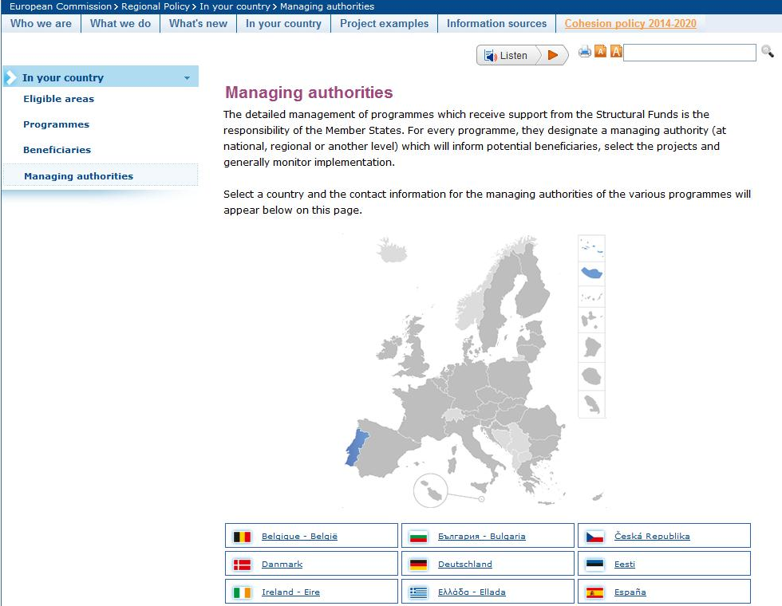
How to identify the relevant ESIF Managing Authorities?
ERDF, ETC & Cohesion Fund http://ec.europa.eu/regional_policy/manage/authority/authority_en.cfm
ESF, Youth initiative & EaSI: http://ec.europa.eu/esf/main.jsp?catId=45&langId=en
EAFRD: http://enrd.ec.europa.eu/general-info/whos-who/implementing-authorities/managing-authorities/en/managing-authorities_en.cfm
EMFF: http://ec.europa.eu/fisheries/cfp/eff/apply_for_funding/index_en.htm
Nota Bene: for the new generation of ESIF programmes in some cases there will be different MAs in charge. The ones in the referenced web-sites will be able to direct you to them.

Slide 29

Links and documents
Guide for authorities on synergies between ESIF and Horizon2020 and other EU programmes: http://ec.europa.eu/regional_policy/activity/research/index_en.cfm
Common Provisions Regulation for the European Structural and Investment Funds: http://ec.europa.eu/regional_policy/what/future/index_en.cfm
  Research and innovation support under ESIF (http://ec.europa.eu/regional_policy/activity/research/index_en.cfm )
  ESF, Youth initiative & EaSI: http://ec.europa.eu/esf/main.jsp?catId=45&langId=en
  EAFRD: http://enrd.ec.europa.eu/general-info/whos-who/implementing-authorities/managing-authorities/en/managing-authorities_en.cfm
  EMFF: http://ec.europa.eu/fisheries/reform/emff/index_en.htm
Horizon 2020 regulations & rules for participation, PPP & P2Ps: http://ec.europa.eu/research/participants/portal/desktop/en/funding/reference_docs.html
COSME regulation: http://ec.europa.eu/cip/cosme/
Erasmus+: http://ec.europa.eu/education/news/20130719-erasmus-plus-preparation_en.htm
Creative Europe: http://ec.europa.eu/culture/creative-europe/index_en.htm
Digital service part of CEF: http://ec.europa.eu/dgs/connect/en/content/public-services-digital-service-infrastructures-connecting-europe-facility

Slide 30



Thematic guides
General research & innovation system building & policy tools
  RIS3 guide
  Universities & regional development
  Service innovation
  Creative industries
  Green growth
  Social innovation
  How to convert research into commercial success
  Science and Technology Parks
  Transnational Learning in Smart Specialisation
  Public procurement of innovation
  Synergies between ESIF, Horizon2020 and other EU programmes
  Soon available: Clusters in less developed regions
SME innovation
  SME innovation
  Incubators
  Entrepreneurial mind-set
  SME internationalisation
Digital growth
  Broadband
  State aid for Broadband
  Digital growth
Available in PDF format here: http://s3platform.jrc.ec.europa.eu/guides

Slide 31
Learn more:
Horizon 2020 Participant Portal:
http://ec.europa.eu/research/participants/portal/desktop/en/opportunities/index.html
Cohesion policy (2014-20)
http://ec.europa.eu/regional_policy/what/future/index_en.cfm

Slide 32

Thank you !
Credits: Katja Reppel, Directorate General for Regional and Urban Policy

