Slide 1
Switzerland in Horizon 2020
Update November 2014

Slide 2
Timeline: Status of Switzerland in Horizon 2020
26 Feb European Commission decides that CH is considered as an Industrialised Third Country in H2020
25 Jun Federal Council approves interim measures for H2020 => Swiss based researchers receive national funding when participating in H2020 projects
15 Sept EU and CH agree on a partial association to H2020 (Pillar I, “Widening”, Euratom)
5 Nov SERI accepts applications for national funding of successful Swiss H2020 beneficiaries in the other programmes (Pillars II & III, SwafS)

Slide 3
pro memoria
Consequences of 3rd Country Status
Multi-Beneficiary Grants in Pillars II & III (RIA, IA, CSA, etc.)
CH participants to be treated normally
include their costs in proposal budgets
but exclude these costs from the requested grant
Successful Swiss participants to be funded nationally
separate application needed
no national re-evaluation of projects, only formal check of budget
no discrimination between different types of projects or types of participants
project coordination still possible for CH institutions and companies

Slide 4
pro memoria
Consequences of 3rd Country Status
Multi-Beneficiary Grants in Pillars II & III (RIA, IA, CSA, etc.)
Grant Preparation:
Art. 57.2: CH beneficiaries must specify whether their national law foresees that they CANNOT be subject to the jurisdiction of the European Court of Justice.
No, there is no such hindrance. CH beneficiaries can be subject to the ECJ’s jurisdiction.

Slide 5
Consequences of Partial Association
Multi-Beneficiary Grants in Pillar I (ITN, FET, Research Infrastructures) Widening, Euratom
CH participants = AC participants in calls with deadlines after 15 Sept 2014

Slide 6
Consequences of Partial Association
Mono-beneficiary grants in Pillar I (ERC, MSCA)
CH participants = AC participants in calls with deadlines after 15 Sept 2014
ERC grants obtained in H2020 calls with a deadline before 15 September 2014:
No portability to CH Host Institution!
Mono-beneficiary grants in Pillars II & III
SME Instrument: CH participants neither eligible nor funded nationally

Slide 7
pro memoria
Please note:
The current situation of CH with regard to H2020 (partial association & 3rd-country status) is still considered to be transitional.
CH is still aiming to become associated to H2020 as of 1 January 2017.

Slide 8
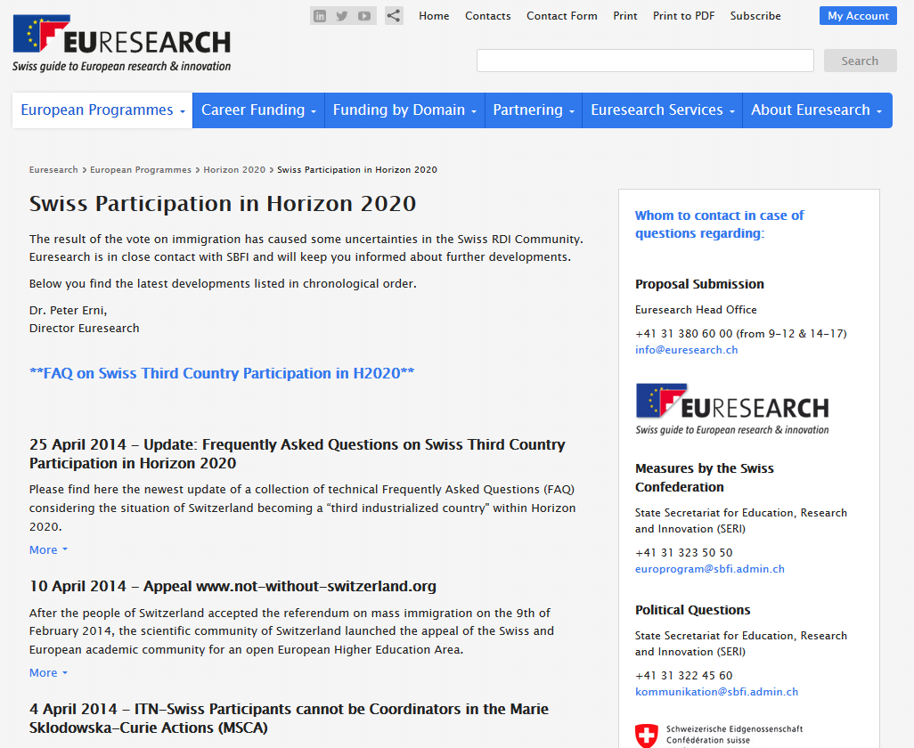
For more information
Dedicated Euresearch Website on CH in H2020 (latest political developments)
Euresearch FAQ on practical questions
Applications for CH National Funding
or contact me: regina.schneider@euresearch.ch +41 / 31 / 380 60 02

